Slide 1
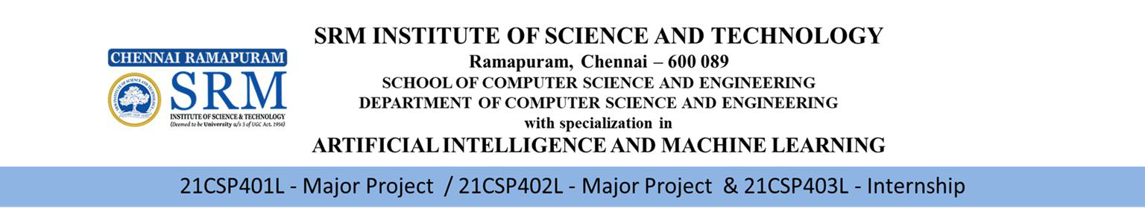
Batch Number: C5
FIRST REVIEW
AI-Based Real-Time Multi-Violation Detection for Two-Wheeler Traffic Using Deep Learning
Team Members | Supervisor
Student Name / Register Number Monica B(RA2211026020150) Danish Ahmed(RA2211026020151) Shruti Swain(RA2211026020176) | Name : Dr. S. S. Sathya Designation : Assistant Professor Department : AI & ML
1

Slide 2
INTRODUCTION
With the rapid growth of urban transportation, two-wheelers constitute a major portion of road traffic, leading to an increase in traffic violations such as helmet non-compliance, triple riding, red signal jumping, and improper number plate display. Traditional traffic monitoring methods rely heavily on manual supervision and isolated rule-based systems, which are inefficient and prone to errors in dynamic real-world conditions. To address these challenges, this project proposes an AI-Based Real-Time Two-Wheeler Multi-Violation Detection System that integrates deep learning-based object detection, multi-object tracking, and conditional OCR. The system leverages advanced computer vision models to detect multiple violations simultaneously from live video streams, ensuring improved accuracy, temporal consistency, and automation in traffic enforcement.

Slide 3
PROBLEM STATEMENT
Increasing two-wheeler traffic violations such as helmet non-compliance, triple riding, mobile phone usage, red-signal jumping, and number plate tampering pose serious road safety risks.
Manual monitoring of these violations through traffic personnel is inefficient, inconsistent, and not scalable in high-density urban traffic.
Existing surveillance systems typically focus on single-violation detection and lack integrated multi-violation analysis for two-wheelers.
Real-time identification of multiple violations in crowded traffic environments requires robust
detection, tracking, and rule-based reasoning mechanisms.
Misinterpretation of visual data due to occlusion, motion, and dense traffic further increases the complexity of automated enforcement systems.

Slide 4
LITERATURE SURVEY
S.No | Author and Year | Description | Limitations
 | Wang, Zheng & Li (2025), IEEE Access | This paper proposes an enhanced License Plate Recognition (LPR) algorithm.The system integrates adaptive preprocessing techniques to handle varying lighting conditions, weather disturbances and motion blur. The proposed framework demonstrates improved robustness in dynamic traffic environments. | The study primarily focuses on license plate recognition and does not integrate helmet detection or multi-violation analysis. The framework does not integrate other traffic violations.
2. | Said et al. (2024), CMES | This research presents an AI-based helmet violation detection system using an optimized PerspectiveNet backbone for feature extraction. The model enhances spatial awareness and improves classification accuracy under varying camera angles and urban traffic conditions. | The system is limited to helmet detection and does not incorporate license plate recognition or multi-rider mismatch detection. It does not include any real-time analysis.
3. | Shoman et al. (2024), Algorithms (MDPI) | This paper proposes an integrated traffic safety framework using YOLOv8 combined with Deep Convolutional Generative Adversarial Networks (DCGANs). The use of GAN-generated synthetic data improves detection robustness under rare and challenging traffic scenarios. | The approach relies significantly on the quality of synthetic data generated by GANs. The system does not incorporate license plate recognition or signal violation detection.

Slide 5
LITERATURE SURVEY
S.No | Author and Year | Description | Limitations
4. | Gehani et al. (2024), Journal of Electrical Systems | This study presents a traffic signal violation detection system using YOLOv8 for object detection and the SORT algorithm for multi-object tracking. The system detects vehicles crossing stop lines during red signals and emphasizes real-time monitoring through video streams. | The system is limited to traffic signal violations and does not include helmet detection or license plate recognition modules. Two-wheeler-specific violation logic is not deeply addressed.
5. | Kuriakose (2025), SSRN | This research integrates helmet detection with license plate recognition for automated traffic rule enforcement. The framework combines deep learning-based object detection models with Optical Character Recognition for automated identification and potential challan generation. | The system does not address multi-violation correlation, such as mismatched helmet detection for pillion riders.Experimental validation on large-scale real-world datasets is limited.
6. | Kathait (2025), International Journal of Computer Applications | This paper proposes a deep learning-based approach for detecting traffic violations using YOLO architecture. The system focuses on identifying helmet violations and other basic traffic rule breaches. The study emphasizes cost-effective deployment in smart city environments. | The system primarily focuses on helmet detection and does not integrate multi-modal violations such as signal crossing and license plate recognition in a unified framework.

Slide 6
LITERATURE SURVEY
S.No | Author and Year | Description | Limitations
7. | Jia et al. (2021), IET Image Processing | This study introduces an improved YOLOv5-based real-time helmet detection system optimized for urban traffic environments. The model incorporates feature fusion. Experimental results show improved precision and recall in real-time helmet detection scenarios. | The framework is limited to helmet detection and does not include license plate recognition or multi-violation analysis. Large-scale deployment is limited.
8. | Deshpande (2025), Frontiers in Artificial Intelligence | This research presents a computer vision-based automatic rider helmet violation detection system using a YOLO-based detection pipeline. It demonstrates reliable helmet detection accuracy in controlled environments. | The system does not incorporate pillion rider analysis or mismatched helmet detection logic. Traffic signal violation detection are not included.
9. | Balakrishnan et al. (2024), ShodhKosh | This paper proposes a deep learning-based traffic violation prediction system integrating helmet detection with number plate recognition. OCR techniques for number plate extraction, aiming at automated enforcement mechanisms. | The system does not explicitly handle multi-rider mismatch detection. Performance under adverse weather and night-time conditions is not included.
10. | Aliane et al. (2014), Sensors | This early study presents a traffic violation detection system using traditional computer vision techniques such as motion detection and rule-based analysis. The framework integrates traffic monitoring with automated reporting mechanisms | The system relies heavily on traditional image processing methods and lacks deep learning-based optimization.It demonstrates lower robustness.

Slide 7
BACKGROUND & MOTIVATION
Two-wheelers contribute significantly to urban traffic density and are frequently involved in safety violations and accidents.
Common violations such as helmet non-compliance, triple riding, mobile phone usage, red-signal jumping, and number plate tampering increase road risk.
Manual traffic enforcement is limited in scalability and consistency, especially in high-density environments.
Recent advancements in deep learning enable real-time object detection and tracking from
surveillance video.
There is a need for an AI-based integrated system capable of detecting multiple two-wheeler violations simultaneously to support efficient traffic monitoring.

Slide 8
OBJECTIVES
To develop an AI-based real-time system for detecting traffic violations specific to two-wheelers.
To detect helmet non-compliance for both rider and pillion using deep learning techniques.
To identify triple riding by performing rider count analysis per motorcycle.
To detect mobile phone usage while riding using object and spatial analysis.
To implement red-signal violation detection using tracking and stop-line crossing logic.
To detect missing or occluded license plates and extract plate numbers using OCR when
violations occur.

Slide 9
SCOPE OF THE PROJECT
Develop an AI-based real-time system for detecting multiple traffic violations specific to two-wheelers.
Detect and analyze violations including helmet non-compliance, triple riding, mobile phone
usage, red signal jumping, and number plate missing/occlusion.
Implement object detection and tracking to ensure temporal consistency across video frames.
Extract license plate numbers using OCR only when a violation is confirmed.
Generate structured violation records with timestamp and visual evidence.
Provide a scalable framework that can be extended to additional traffic rules in the future.

Slide 10
TOOLS TO BE USED
Development Tools
Python – Core programming language
PyTorch – Deep learning framework for model training & inference
OpenCV – Image processing and video frame handling
Google Colab – Model training and experimentation
SQLite – Violation record storage
AI Models & Libraries
YOLO26 – Multi-object detection
Constraint-Aware SORT – Object tracking
TrOCR – Transformer-based license plate recognition
MediaPipe – Pose estimation for phone detection

Slide 11
HARDWARE AND SOFTWARE REQUIREMENTS
Hardware Configuration
Processor: Intel i5 / Ryzen 5 or higher (multi-core recommended).
Memory: 8 GB RAM (minimum), 16 GB RAM (recommended).
GPU (Optional but Recommended): NVIDIA CUDA-enabled GPU for real-time YOLO
inference.
Input Device: Surveillance/IP camera for live video feed.
Software Environment
Programming Language: Python 3.8+.
Object Detection: Ultralytics YOLO framework.
Video Processing: OpenCV.
Tracking Module: Constraint-Aware SORT (for multi-object tracking).
License Plate Recognition: TrOCR (Transformer-based OCR).

Slide 12
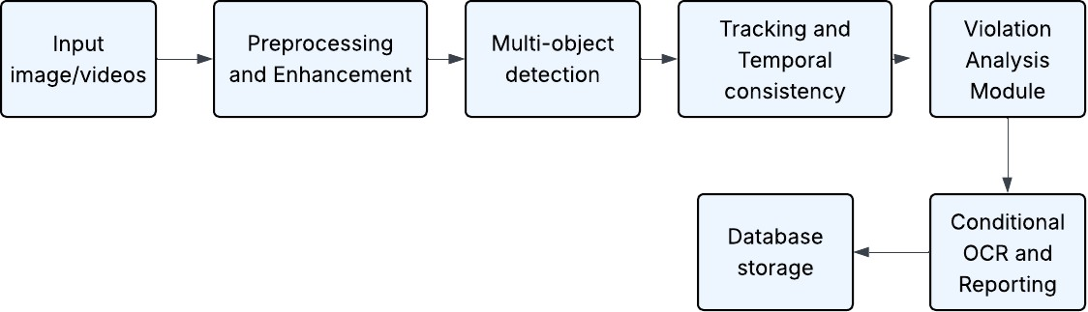
FUNCTIONAL BLOCK DIAGRAM OF THE PROPOSED METHOD

Slide 13
METHODOLOGY
Module 1: Video Input & Frame Management
Capture real-time two-wheeler traffic video from surveillance camera
Extract frames at fixed FPS for processing
Define stop-line and traffic signal ROI
Module 2: Preprocessing & Enhancement
Resize and normalize frames for model compatibility
Apply noise reduction and contrast enhancement
Crop relevant regions to improve computational efficiency
Module 3: Multi-Object Detection (YOLO26)
Detect motorcycle, rider/pillion, helmet, phone, and license plate
Generate bounding boxes with class labels and confidence scores
Apply thresholding to remove low-confidence detections

Slide 14
METHODOLOGY
Module 4: Tracking & Temporal Consistency (Constraint-Aware SORT)
Assign unique IDs to vehicles across frames
Maintain temporal consistency using Kalman filtering
Apply stop-line and motion-direction gating
Module 5: Violation Analysis Module
Helmet compliance (rider & pillion)
Triple riding detection
Mobile phone usage detection
Red signal crossing detection
Plate missing / occlusion detection
Module 6: Conditional OCR & Reporting
Extract plate number (TrOCR)
Store violation details and generate output

Slide 15
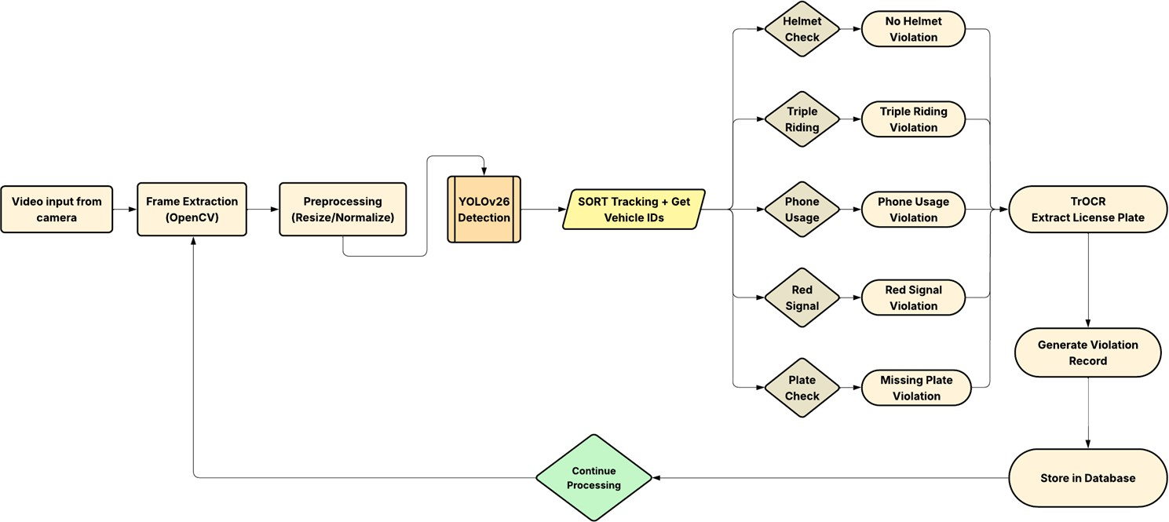
ARCHITECTURE DIAGRAM

Slide 16
PRELIMINARY RESULTS AND DISCUSSION
Preliminary Work Completed
Two-wheeler violation dataset collected and structured in YOLO format
Classes defined: bike, rider, helmet, no_helmet, number_plate
Data split prepared (train/val/test)
Architecture finalized
Model selected: YOLO26 + Constraint-Aware SORT + TrOCR
Helmet Violation Detection Results
System successfully detects:
Riders without helmets
Riders wearing helmets
Violations highlighted in real-time with bounding box overlays
Detection stable under daylight conditions
Minor accuracy drop observed in:
Low-light
Motion blur

Slide 17
PRELIMINARY RESULTS AND DISCUSSION
Triple Riding Detection Results
Triple riding detected using:
Bike detection
Multiple head-region detections overlapping same bike
Rule-based counting logic implemented
Accurate when riders are clearly visible
Performance affected when:
Riders overlap
Camera angle is extreme
Comparative Analysis
Compared with baseline YOLOv5 implementation:
Proposed configuration shows improved detection stability.
Reduced false positives for helmet detection.
Further tuning planned to improve recall.

Slide 18
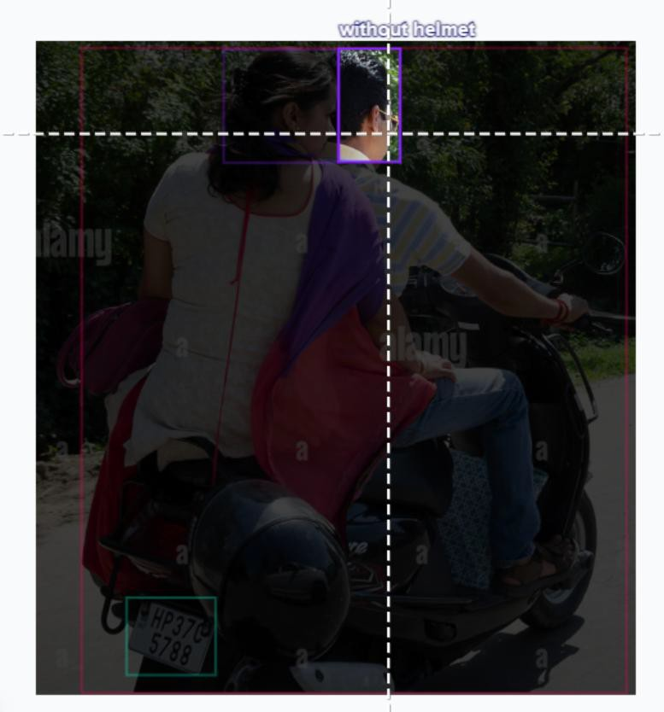
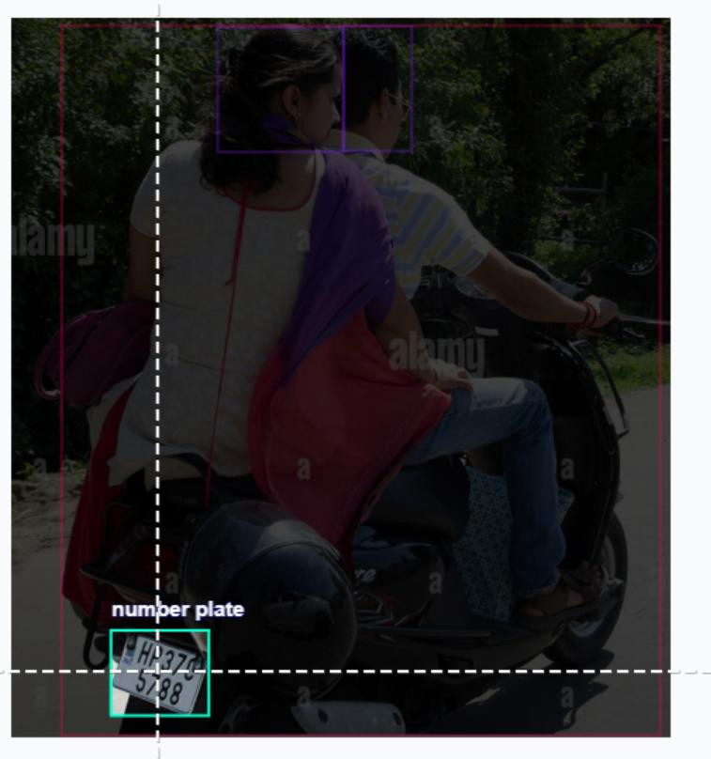
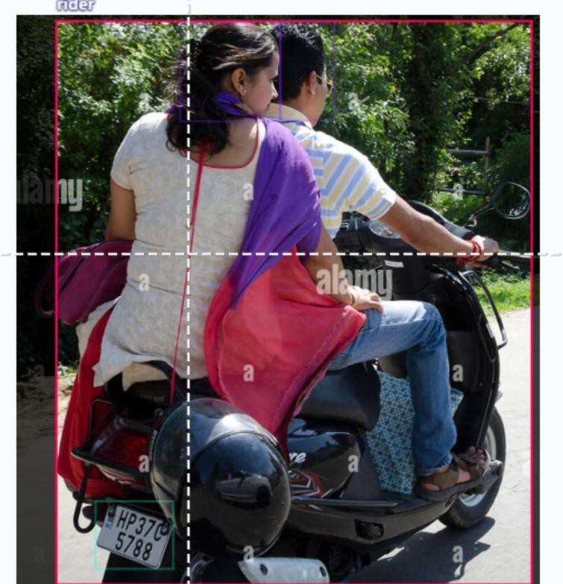
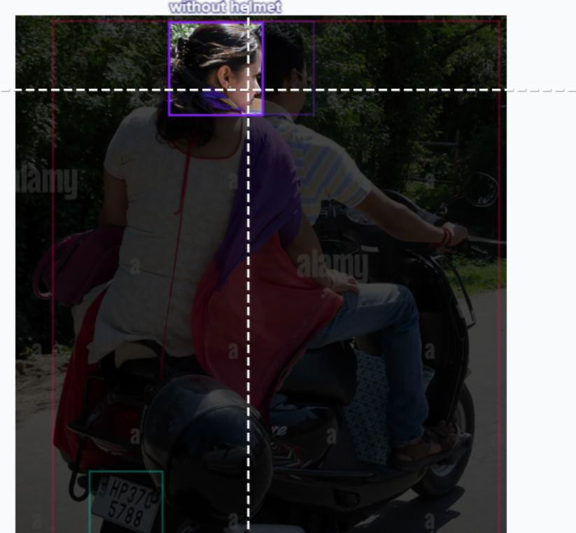
PRELIMINARY RESULTS AND DISCUSSION
HELMET AND LICENCE PLATE DETECTION OUTPUT

Slide 19
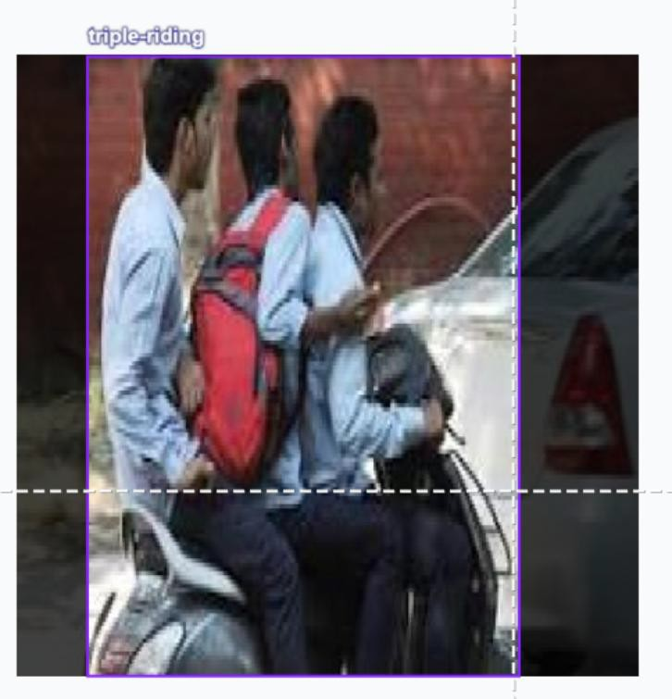
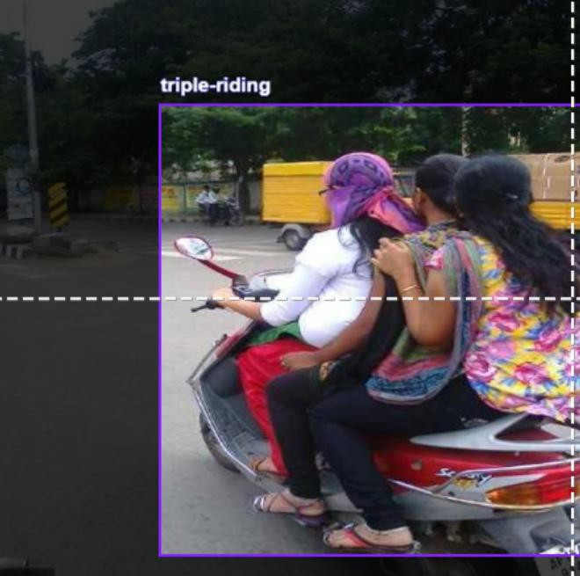
PRELIMINARY RESULTS AND DISCUSSION
TRIPLE RIDING DETECTION OUTPUT

Slide 20
PRELIMINARY RESULTS AND DISCUSSION
Performance Evaluation
helmet detection module successfully detects helmet and no-helmet riders in real-time.
triple riding detection implemented using rider-count logic per detected bike.
detection stable under normal daylight traffic conditions.
minor performance drop observed during motion blur and occlusion.
Comparison with Existing Systems
Traditional rule-based systems show lower robustness in dynamic conditions.
Existing single-violation models lack multi-rule integration.
Proposed YOLO26 + Constraint-Aware Tracking improved temporal stability.
Transformer-based OCR achieved higher accuracy compared to conventional OCR.

Slide 21
REFERENCES
Z. Wang, L. Zheng and G. Li, "Design of Enhanced License Plate Information Recognition Algorithm Based on Environment Perception," in IEEE Access, vol. 13, pp. 38609-38627, 2025.
Y. Said, Y. Alassaf, R. Ghodhbani, et al., “AI-Based Helmet Violation Detection for Traffic Management System,” CMES: Computer Modeling in Engineering & Sciences, 2024 — deep learning approach for helmet violation detection with optimized PerspectiveNet/EfficientNet backbone.
M. Shoman et al., “Enforcing Traffic Safety: A Deep Learning Approach,” Algorithms (MDPI), 2024 — integrated helmet violation method with YOLOv8 and DCGANs for enhanced accuracy.
H. Gehani, S. Rathod, S. Kumar, P. Purve, P. Gogte, P. Agrawal, N. Katariya, “Traffic Signal Violation Detection System Using Computer Vision,” Journal of Electrical Systems, 2024 — traffic signal violation detection with YOLOv8
+ SORT.
A. Kuriakose, “Helmet Detection and License Plate Recognition Using Deep Learning,” SSRN Electronic Journal, 2025
— system integrating helmet detection and LPR for rule enforcement.

Slide 22
REFERENCES
D. Kathait, “Deep Learning-based Approach for Detecting Traffic Violations,” International Journal of Computer
Applications, 2025 — DL method for helmet and other rule violations using YOLO.
Z. Jia et al., "Real-time automatic helmet detection of motorcyclists in urban traffic using improved YOLOv5 detector," IET Image Processing, vol. 15, no. 14, pp. 3623-3637, 2021. DOI: 10.1049/ipr2.12295
U. U. Deshpande, Computer-Vision Based Automatic Rider Helmet Violation Detection, Frontiers in Artificial Intelligence, 2025 — YOLO-based violation detection in traffic.
G, Balakrishnan & M, Dhinakaran & A, Dinesh & M, Gokul & T, Akash. (2024). TRAFFIC VIOLATION PREDICTION USING DEEP LEARNING BASED ON HELMETS WITH NUMBER PLATE RECOGNITION. ShodhKosh: Journal of
Visual and Performing Arts. 5.
Aliane, Nourdine & Fernández, Javier & Mata, M. & Bemposta Rosende, Sergio. (2014). A System for Traffic Violation Detection. Sensors. 14. 22113-22127. 10.3390/s141122113.

